Slide 1


Using Pedagogy and Classroom Exercises to
Build Resilience

Slide 2

Changes in neurology and behaviour
Epigenetic shifts
2. ADHD
3. Neurological changes
4. Loneliness
5. Long-term stress

Slide 3
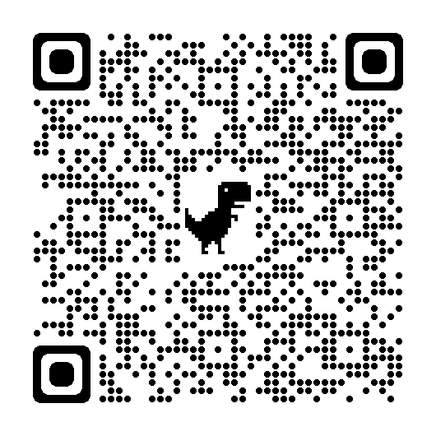
Scan the QR Code to access today’s resources on Trello

Slide 4

Using pedagogy to build resilience

Slide 5
Idea 1: Embracing fear in the present day is good practice for the working world (Booklet pages 6-9)
How does this build resilience?
Learners need to know that fear is a neuro reaction that can be controlled.
Teenagers struggle with reasoning.
What is the pedagogy? Piaget’s constructivism
Real-life scenarios will help a learner to understand the topic being presented
Tasks that are authentic help memorisation

Slide 6
Lesson objectives:
Realise fear is rational
Practice techniques from managing workplace scenarios
Relate this workplace scenario to everyday life
Task and resources:
Task 1. Show animation of fear in the brain
Task 2. Provide a vocationally based scenario and groups come up with a list of ways to cope with this scenario and calm their amygdalae
Task 3. Have a class debate on effective ideas
Task 4. Grounding techniques (i.e., water, 5,4,3,2,1 and ice method)

Slide 7
Idea 2. Get ready to embrace, enjoy and manage change because the working world, as well as our personal lives, will be filled with it (Booklet pages 9-15).
How does this build resilience?
Prepare learners for future change that will inevitably occur
Realise that change is just a moment in time that will pass
What is the pedagogy? Vygotsky’s Social Constructivism
Zone of Proximal Development
Model, Question, Independent and Automatization

Slide 8
Lesson objectives:
Recognise that change is inevitable
Take-away strategies to manage changes
Decide if problem-solving tools are useful
Task and resources:
Task 1. Show animation of John who is becoming a father
Task 2. Questions to help take ownership
Task 3. Subject-based problem (i.e., your company is moving, strategise on the fishbone)
Task 4. Interleaving to help automatization

Slide 9
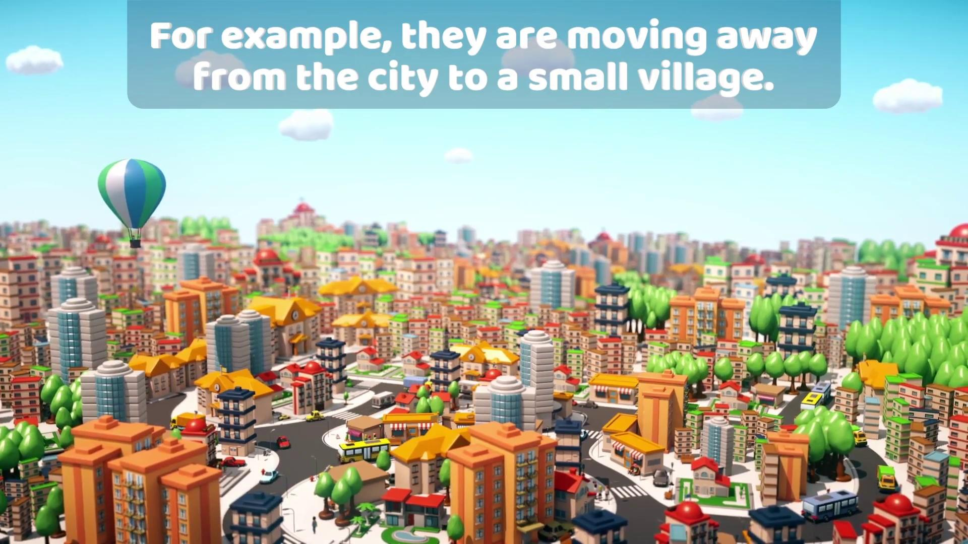

Slide 10
Idea 3. Oranges from Valencia (Booklet pages 16-22)
How does this build resilience?
Negotiation skills help us to manage conflict with empathy
Provides an important tool in our ‘bag of tricks’
What is the pedagogy? Cognitive psychology
How the brain memorises
Action, doing and movement is key to this

Slide 11
Lesson objectives:
1. Take-away negotiation techniques for any situation
2. Recognise the benefit of showing empathy to others
3. Practice negotiations skills to help memorise methods
Task and resources:
Task 1. In groups, learners explore negotiation techniques
Task 2. Provide oranges to both groups and start the task
Task 3. Learners identify successful techniques and how positive language helped

Slide 12
Idea 4. Lesson in a Tardis to realise our place in history (Booklet pages 22-24)
How does this build resilience?
Helps learners recognise now is only a moment in time
Recognising we can contribute to history
Explore time management tips (optional)
What is the pedagogy? Frederic Bartlett’s Schema Theory
Familiar things build memories
Improved recall

Slide 13
Lesson objectives:
Realise that the areas we are studying have a history and others have paved the way sometimes at great sacrifice
Reflect on how we may become a part of this history
Our point in history is only a short moment
Task and resources:
Task 1. Dr Who theme tune to help remind learners
Task 2. Research topic through time
Task 3. Present difference on eras and reflect on our generation’s contribution

Slide 14
Idea 5. Communication skills to help the learner be assertive at work (Booklet pages 24-32)
How does this build resilience?
Under the pillar of emotional resilience, you can help your learners find easy sentences that will help them to be calm but assertive
Helps learners realise that a part of being a positive employee is accepting justified comments but speaking up when needed
What is the pedagogy? Liberationism
The tutor helps the learner to find freedom through education
How can you learn when you are hungry and cold?

Slide 15
Lesson objectives:
Take away communications strategies
Learn the difference between rudeness and expression of rights
Build assertion skills
Task and resources:
Task 1. Learners explore the communication techniques given
Task 2. Learners are given scenarios and they match these to the techniques
Task 3. Learners practice these ideas

Slide 16
Lessons that directly discuss resilience and coping skills

Slide 17

Overcoming self-sabotage

Slide 18
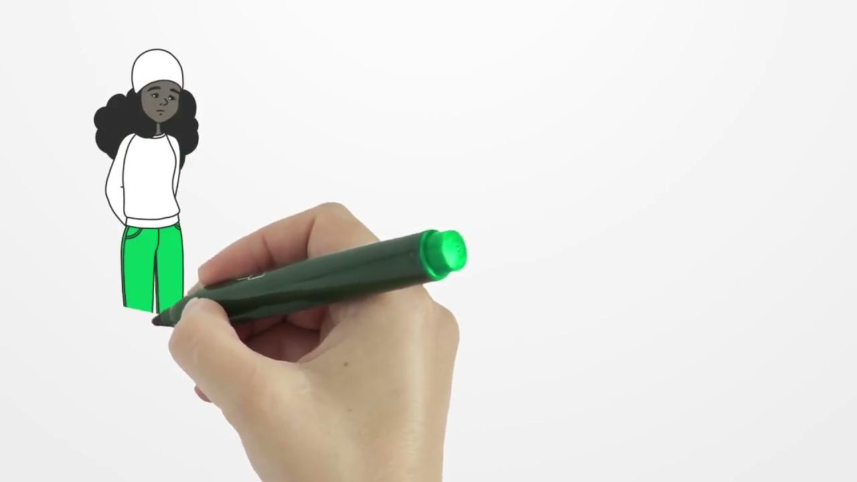
How does stress make you feel?

Slide 19

A Beginner’s Guide to Having Good Self-Esteem

Slide 20

Body confidence

Slide 21
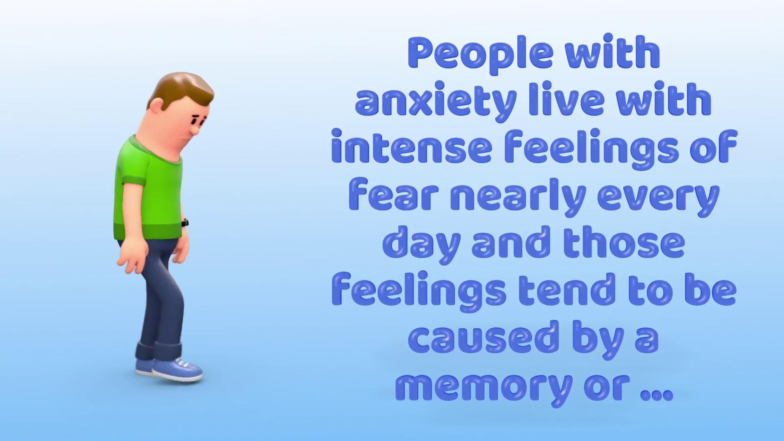
The difference between stress and anxiety

Slide 22
Scan the QR Code to access today’s resources on Trello

